Slide 1

PRESENTATION
DIABETES PREDICTION USING MACHINE LEARNING
PREPARED BY:
SOHA SHAARAWY
SUPERVISED BY:
MOHAMED ELSAYEH

Slide 2

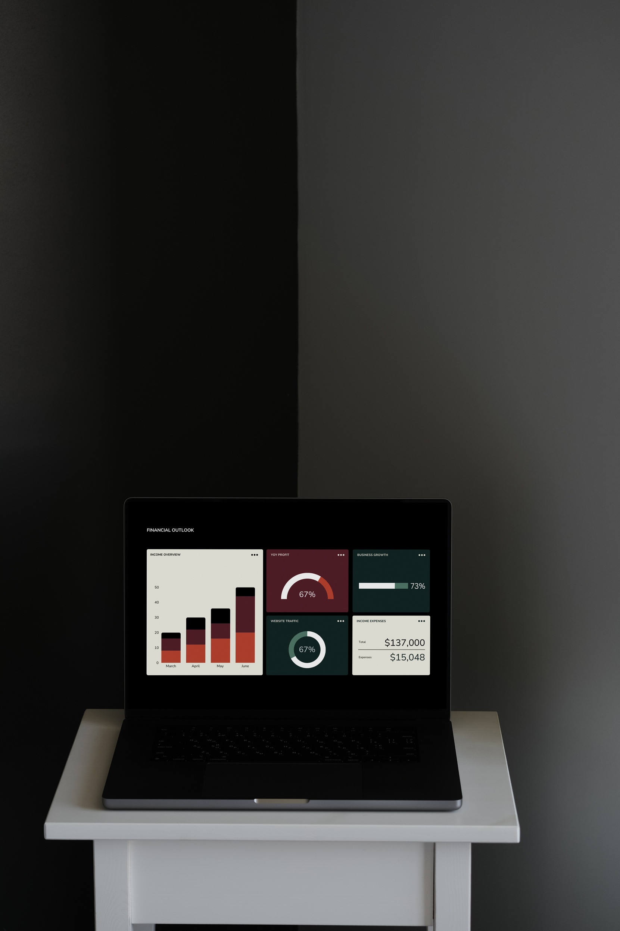
PROJECT OVERVIEW
Diabetes is considered one of the most common chronic diseases worldwide. Early prediction and diagnosis of diabetes can help reduce serious complications and improve patient healthcare.
This project aims to develop a machine learning model capable of predicting diabetes based on clinical and demographic patient data. The project includes data preprocessing, exploratory data analysis, feature engineering, model training, evaluation, and deployment using Streamlit.

Slide 3

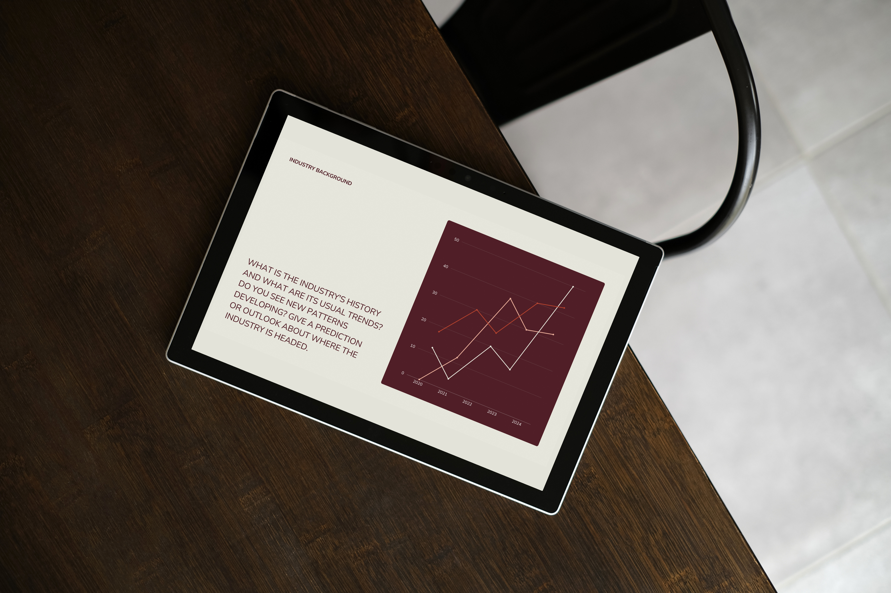
PROBLEM STATEMENT
The main objective of this project is to answer the following question:
Can machine learning algorithms accurately predict whether a patient is diabetic based on medical and demographic features?
This prediction system can support healthcare professionals in early diagnosis and decision-making.

Slide 4


DATASET DESCRIPTION
Dataset Name:
Comprehensive Diabetes Clinical Dataset (100k rows)
Source:
Kaggle
Dataset Characteristics:
• More than 100,000 patient records
• More than 10 clinical and demographic features
• Real-world healthcare-related data
• Contains categorical and numerical variables
• Includes missing values and data imbalance
Target Variable:
Diabetes
0 = Non-diabetic
1 = Diabetic

Slide 5
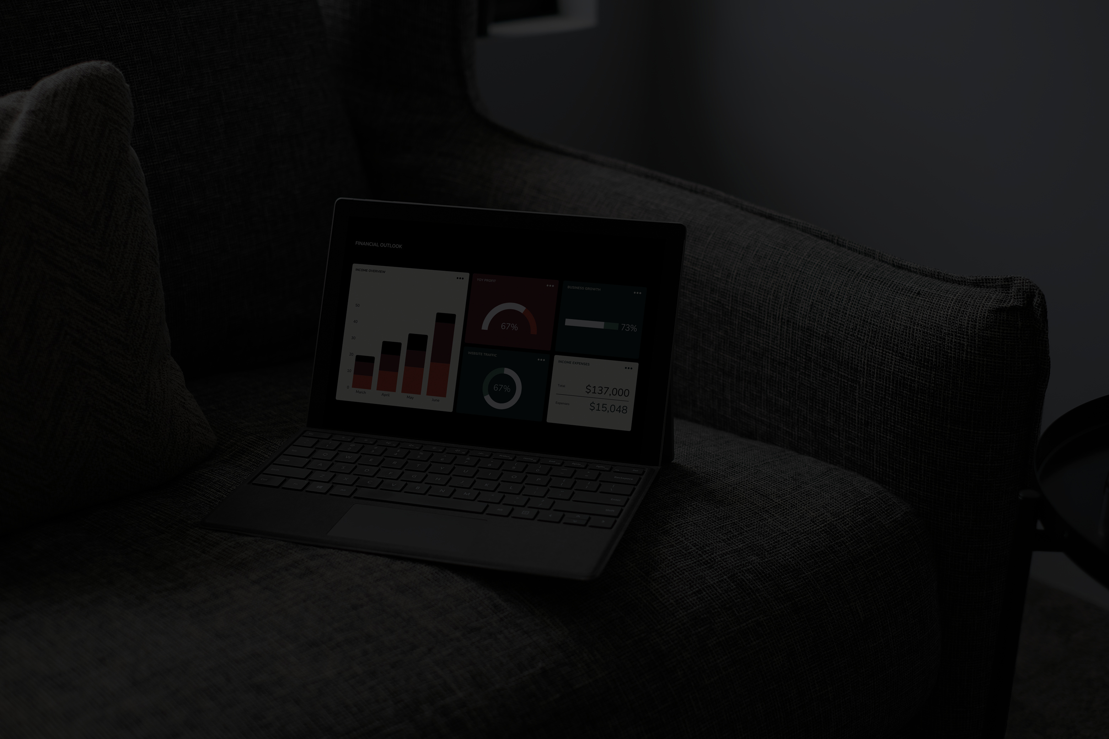
FEATURES USED
The dataset includes several important medical and demographic features such as:
• Age
• Gender
• Body Mass Index (BMI)
• Hypertension
• Heart Disease
• Smoking History
• HbA1c Level
• Blood Glucose Level
These features are highly related to diabetes diagnosis and prediction.

Slide 6
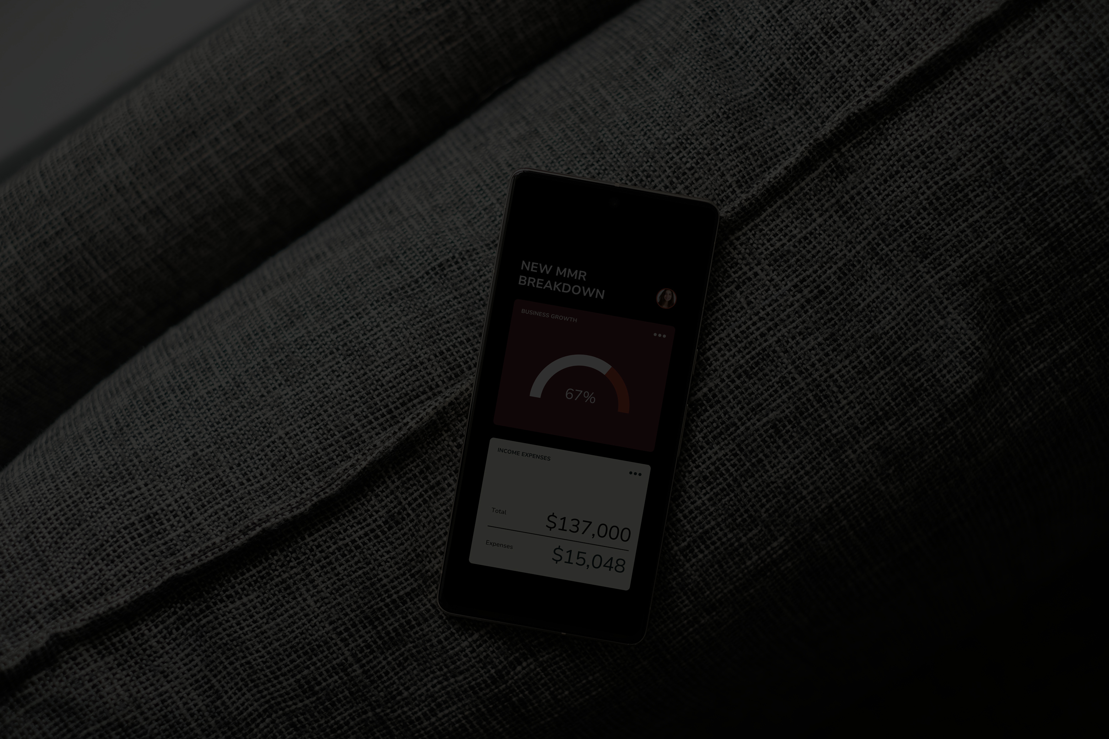
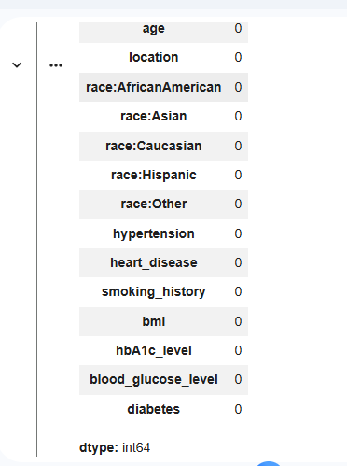
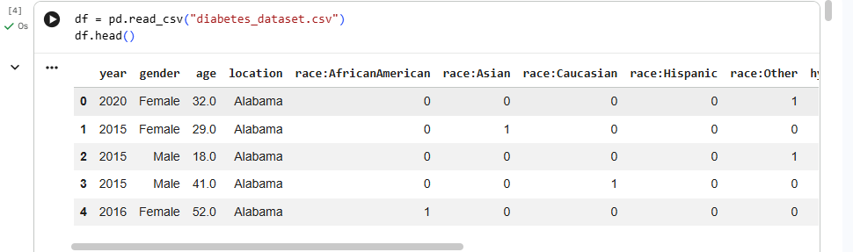
DATA CLEANING
Data preprocessing and cleaning steps included:
• Handling missing values
• Removing duplicated records
• Checking data consistency
• Converting categorical variables into numerical format
• Scaling numerical features using StandardScaler
These steps improved data quality and model performance.

Slide 7

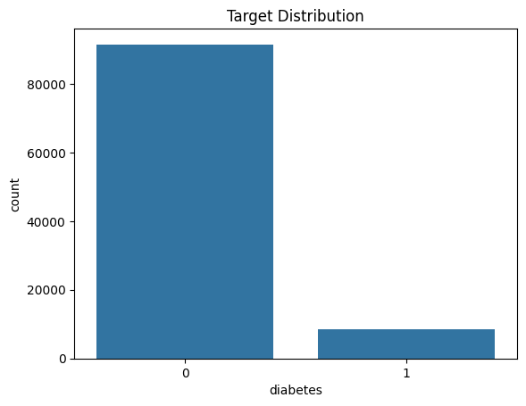
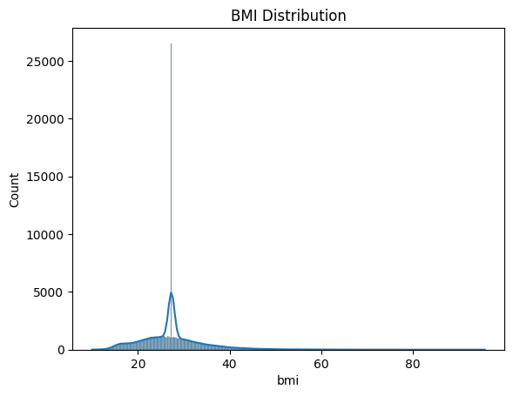
EXPLORATORY DATA ANALYSIS (EDA
Exploratory Data Analysis was performed to understand the dataset and identify patterns.
The analysis included:
• Univariate analysis
• Bivariate analysis
• Correlation analysis
Different visualizations were created such as:
• Histograms
• Boxplots
• Countplots
• Scatter plots
• Heatmaps

Slide 8
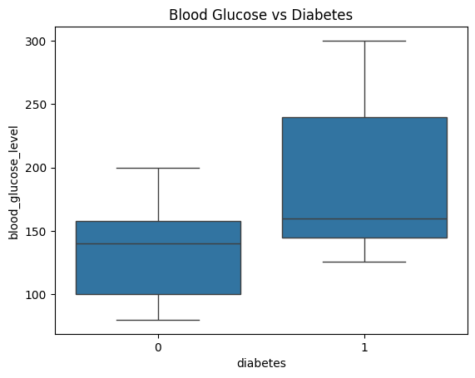
IMPORTANT INSIGHTS
Several important observations were identified during the analysis:
• Higher glucose levels are strongly associated with diabetes.
• Patients with high BMI showed a higher diabetes risk.
• Hypertension and heart disease were more common among diabetic patients.
• Older age groups had a greater probability of diabetes occurrence.

Slide 9
FEATURE ENGINEERING
Feature engineering was applied to improve model performance.
New features created:
• Age Groups
• BMI Categories
These engineered features helped the models better understand patient risk patterns.

Slide 10
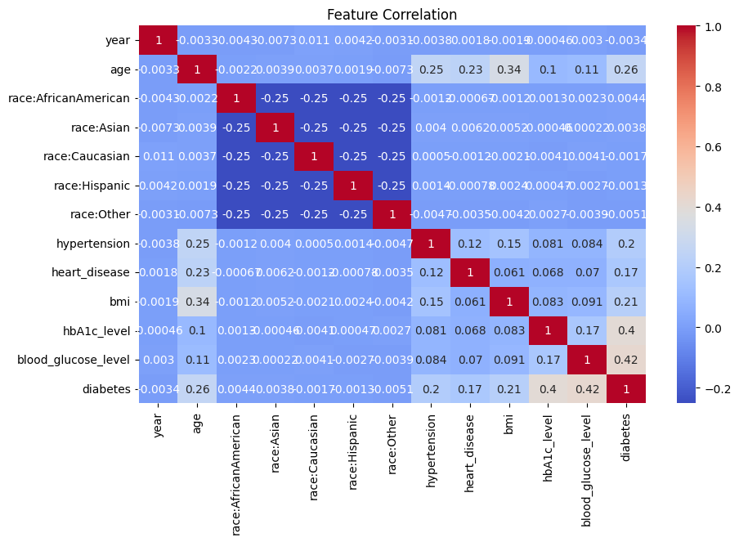
FEATURE SELECTION
Feature importance analysis was used to identify the most influential variables.
The most significant features included:
• Blood Glucose Level
• HbA1c Level
• BMI
• Age
Feature selection helped reduce unnecessary complexity and improve prediction efficiency.

Slide 11
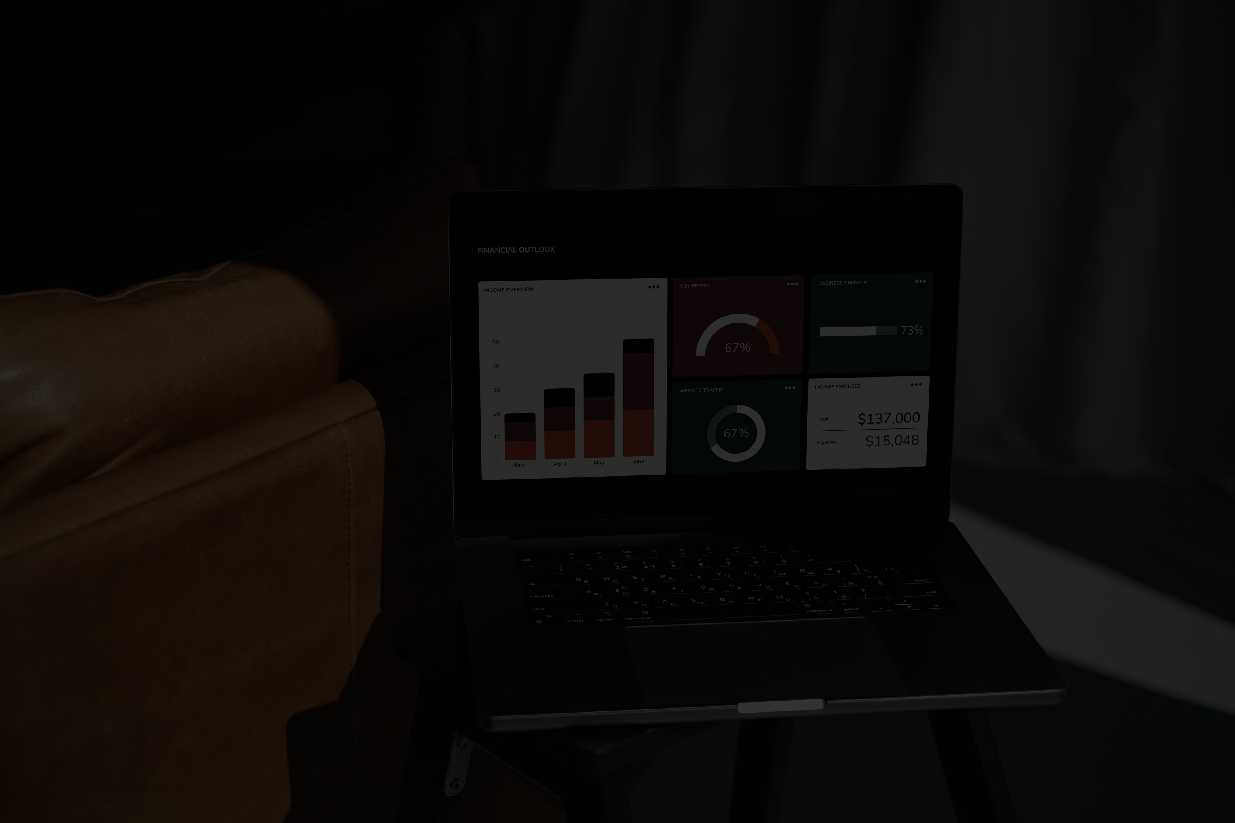
MACHINE LEARNING MODELS
Three machine learning algorithms were implemented and compared:
1. Logistic Regression
2. Random Forest Classifier
3. Gradient Boosting Classifier
The objective was to compare performance and identify the best-performing model.

Slide 12
MODEL EVALUATION
The models were evaluated using multiple evaluation metrics:
• Precision
• Recall
• F1-score
• Confusion Matrix
These metrics provide a comprehensive understanding of model performance, especially for medical classification problems.

Slide 13
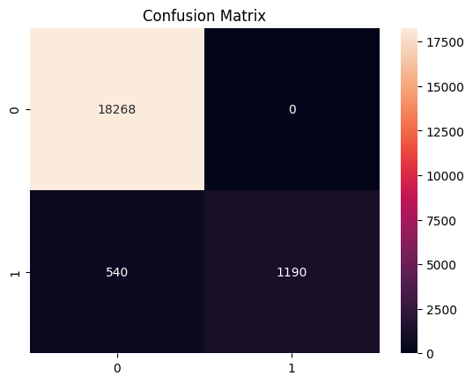
BEST MODEL PERFORMANCE
The Random Forest model achieved the best overall performance compared to the other algorithms.
The model demonstrated:
• High prediction accuracy
• Strong recall performance
• Good balance between precision and recall
This makes the model suitable for diabetes prediction tasks.

Slide 14
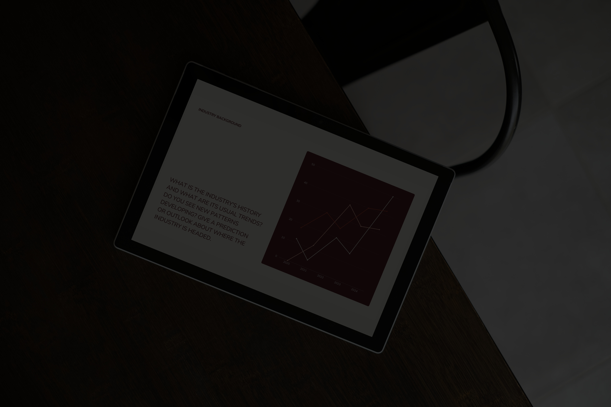

CONCLUSIONS
This project demonstrated the effectiveness of machine learning in predicting diabetes using clinical data.
The developed system achieved strong predictive performance and can support healthcare systems in early disease detection and decision-making.
Future improvements may include:
• Using deep learning techniques
• Adding more clinical variables
• Deploying the model on cloud platforms

Slide 15
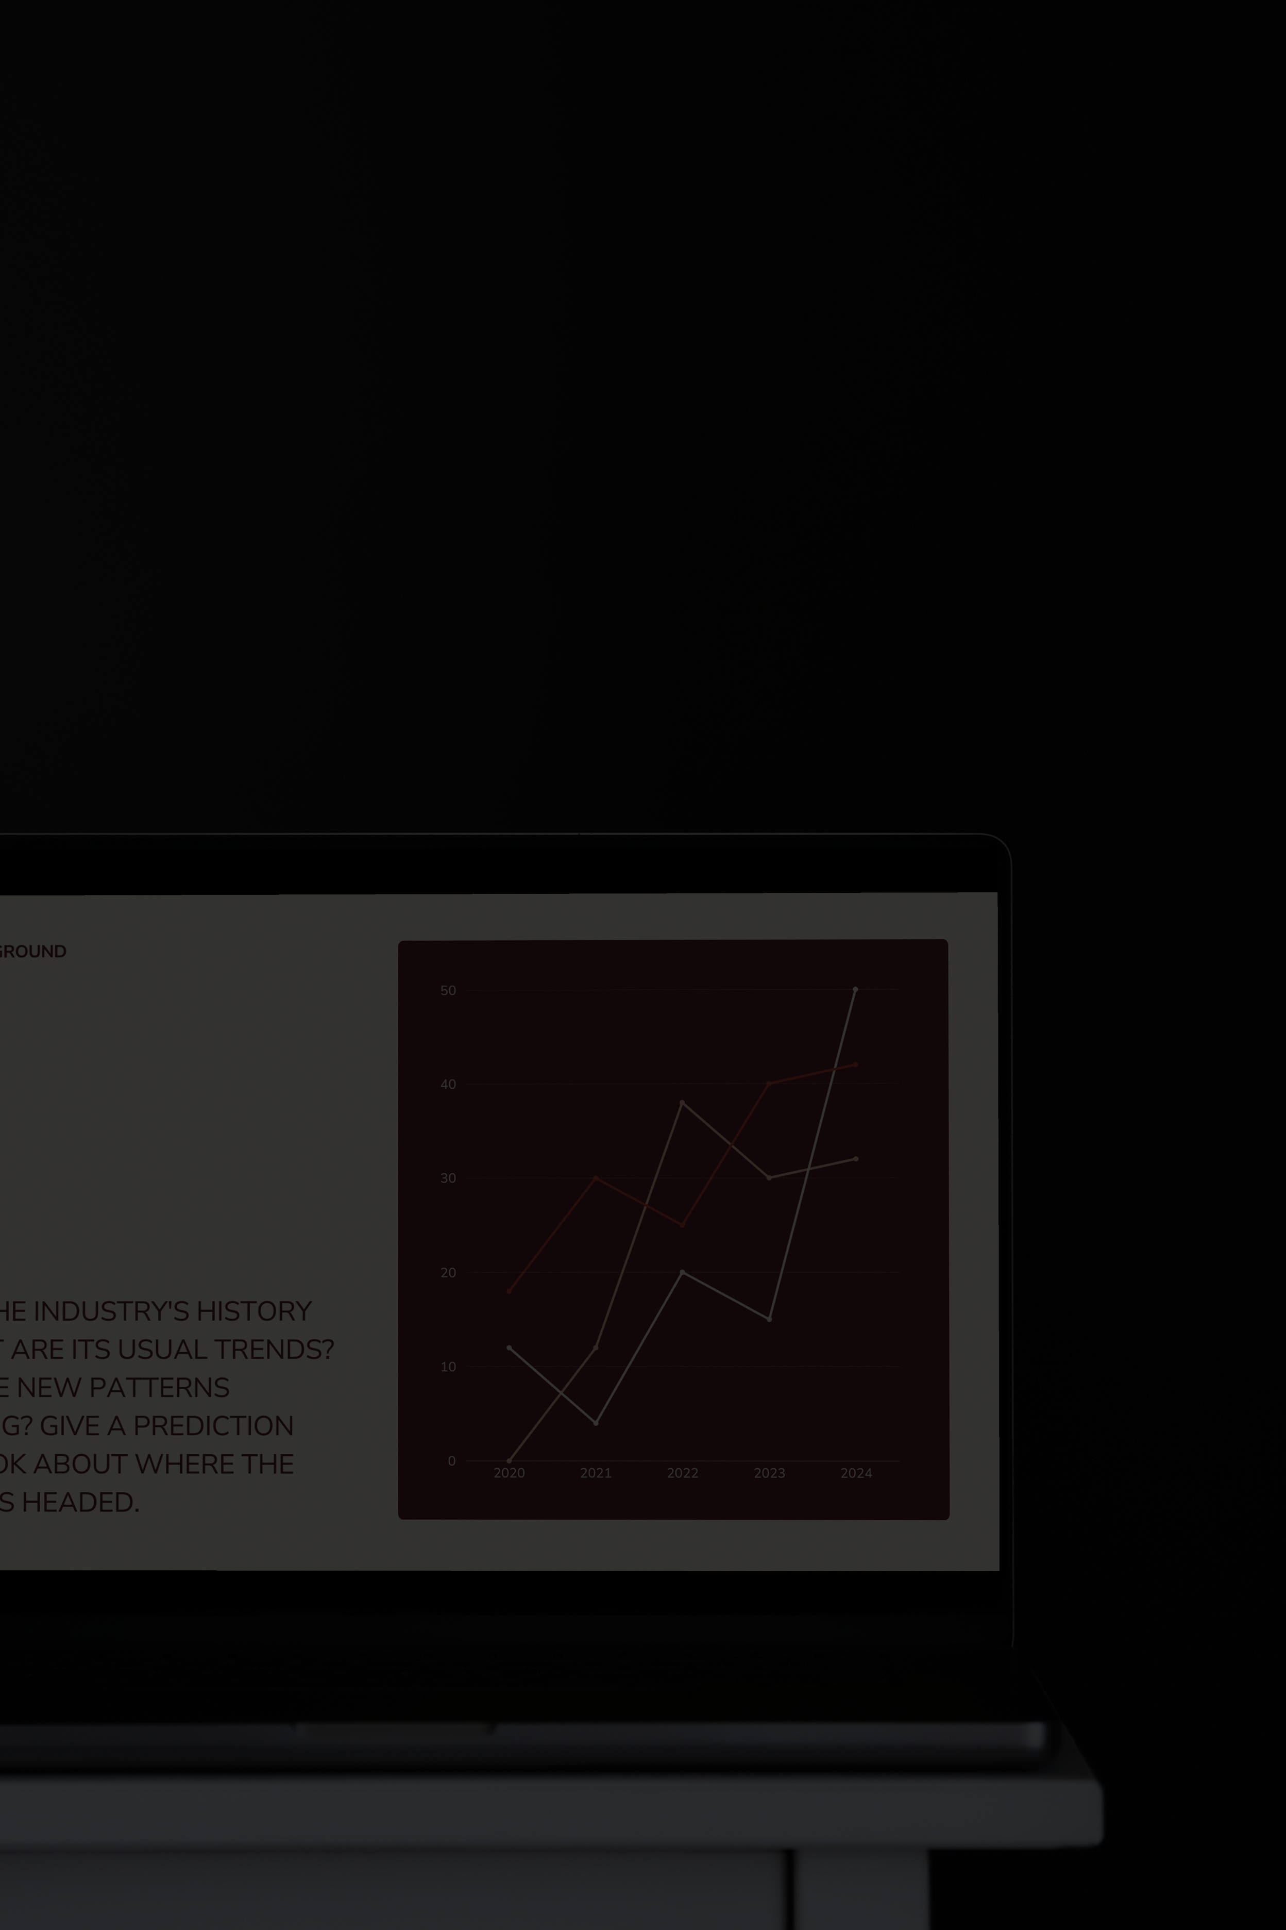
THANK YOU
FOR YOUR ATTENTION

